Slide 1
Spaceship Titanic
Team 2

Slide 2
Agenda
01)
04)
02)
05)
03)
Overview of Competition
Best Model and R Demonstration
Critique of Other Submissions
Q & A
Descriptions of our Models

Slide 3
Overview of Competition
Similar to popular Titanic competition with a futuristic twist
Objective:
  Predict the passengers transported to an alternate dimension by a space anomaly
Data Set:
  Found in Kaggle
    14 columns with 8,693 rows in train.csv
    13 columns with 4,277 rows in test.csv
Key Features:
  PassengerId, HomePlanet, CryoSleep, Cabin, Destination, Age, VIP, RoomService, FoodCourt, ShoppingMall, Spa, VRDeck, Name
Target:
  Transported
Notes:
ML2 Final Project Details Doc in Shared Drive has what we originally wrote for problem statement/objective; need to include where data comes from on Kaggle (did Kaggle make it up?), give descriptions of each column within the data, explain why we did not use the test data set here, what is our target and features
Description: https://www.kaggle.com/c/spaceship-titanic/

Slide 4
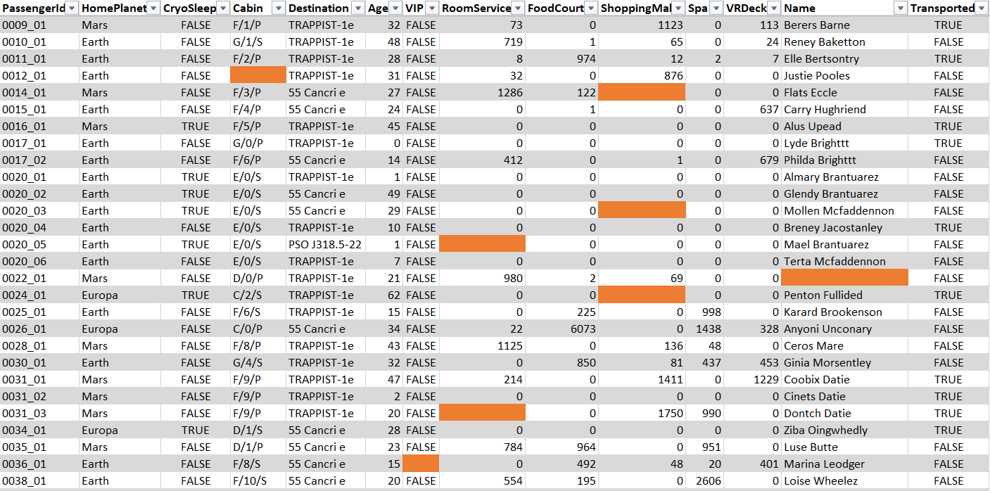

Slide 5
Critique of Other Submissions - GLM
Solution 1: GLM Submission
Results:
  Test Accuracy: 0.8011043
  Test Error: 0.1988957
Strengths:
  Multiple model approaches (Lasso, Ridge, Elastic Net)
Critiques:
  Unnecessary data augmentation
  Irrelevant factors split then removed
    Passenger Name
    Cabin
Notes:
https://www.kaggle.com/code/negoto/r-logistic-regression-baseline
ML2 Final Project Details Doc in Shared Drive has what we originally wrote

Slide 6
Critique of Other Submissions - Random Forest
Solution 2: Random Forest Submission
Results:
  Train Accuracy: 0.9199
  Train Error: 0.0801
Strengths:
  Best model accuracy of all R submissions on Kaggle
  Model is tuned in submission
  Can dynamically calculate which columns to remove from model
Critiques:
  Splitting of categorical factors (Passenger Name, Cabin)
  Addition of “Total Fee” column in data set
  Unconventional handling of NAs in columns
Notes:
https://www.kaggle.com/code/jaehob/space-titanic-randomforest-prediction-r#Modeling
ML2 Final Project Details Doc in Shared Drive has what we originally wrote

Slide 7
Our Models
 | SVM | XGBoost | Random Forest | Logistic Regression
Test Accuracy | 0.7922 | 0.7898 | 0.7826 | 0.8059
Test Error | 0.2078 | 0.2102 | 0.2174 | 0.1941

Slide 8
Best Model
Logistic Regression
Live Demonstration
Notes:
More in depth description of model that had best accuracy rate

Slide 9

Questions?

